Slide 1
End of Year Review Step – Performance Review
End of Year review consists of 3 sub steps: Self Review, Mgr Review and One to One Review.
You and your manager rate your performance and competencies for the past year and then have a one to one discussion
This takes place April – May each year
Forms are automatically routed via workflow
More information will be available to you prior to April next year

Slide 2
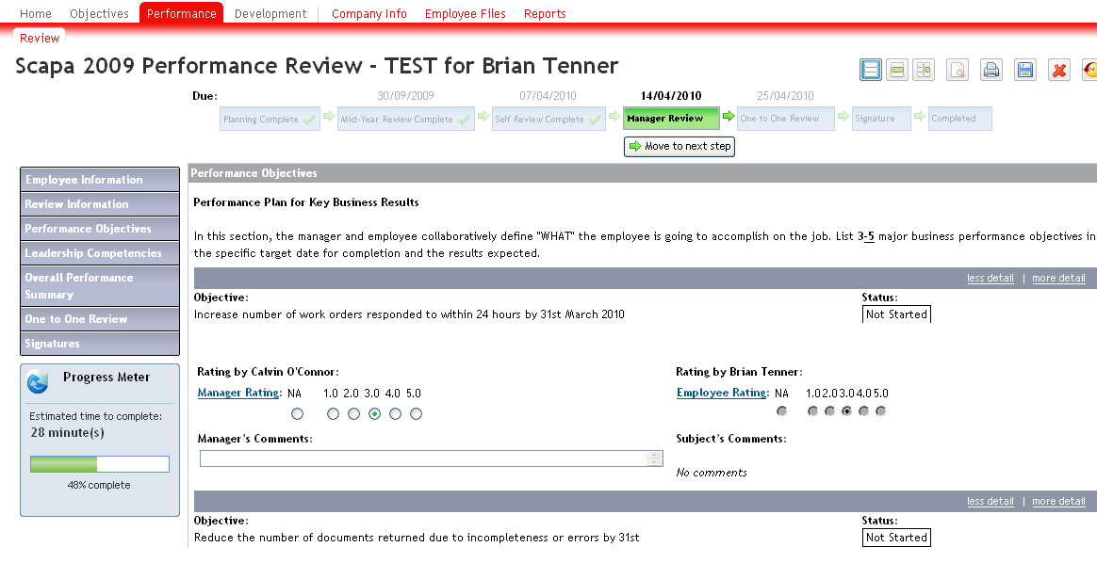
End of year Review Step – Performance Review
Both Employee and Manager complete ratings for Performance Objectives and Competencies

Slide 3
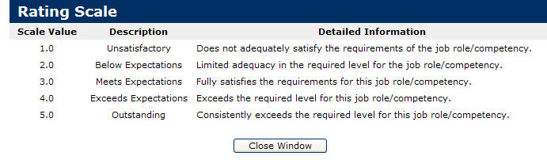
End of Year Review Step - Manager/Employee Rating Scales

Slide 4
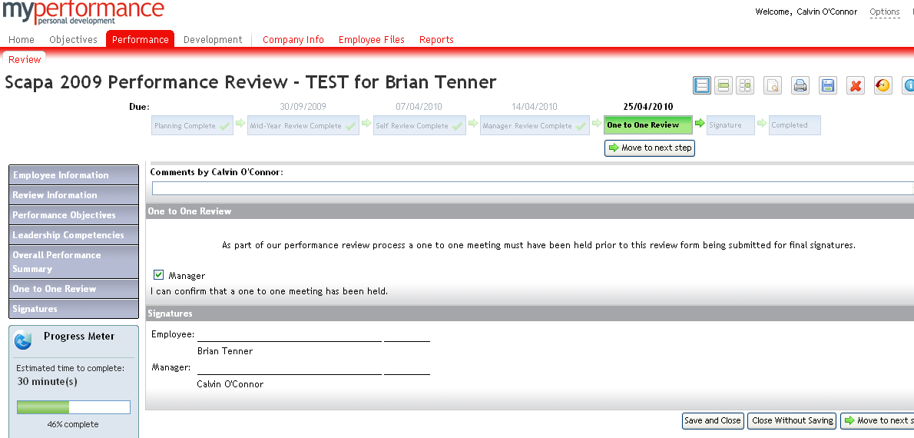
End Year Review Step – Performance Review
This must be ticked by the Manager to initiate ‘move to next step’
Manager will arrange a one to one review meeting and then click here to move to the next step
Click here to ‘save’

Slide 5
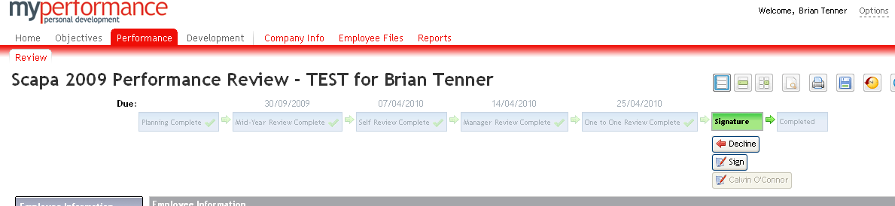
Signature Step – End of Year Review
The employee has the option to ‘sign’ or ‘decline’ and make comments as appropriate. The form moves to the ‘completed step’

